Slide 1
NOVA AI – Conversational Intelligence Agent
Methodology: SDLC (Software Development Life Cycle) Technology: Python, Flask, AI Models Presented by:

Slide 2
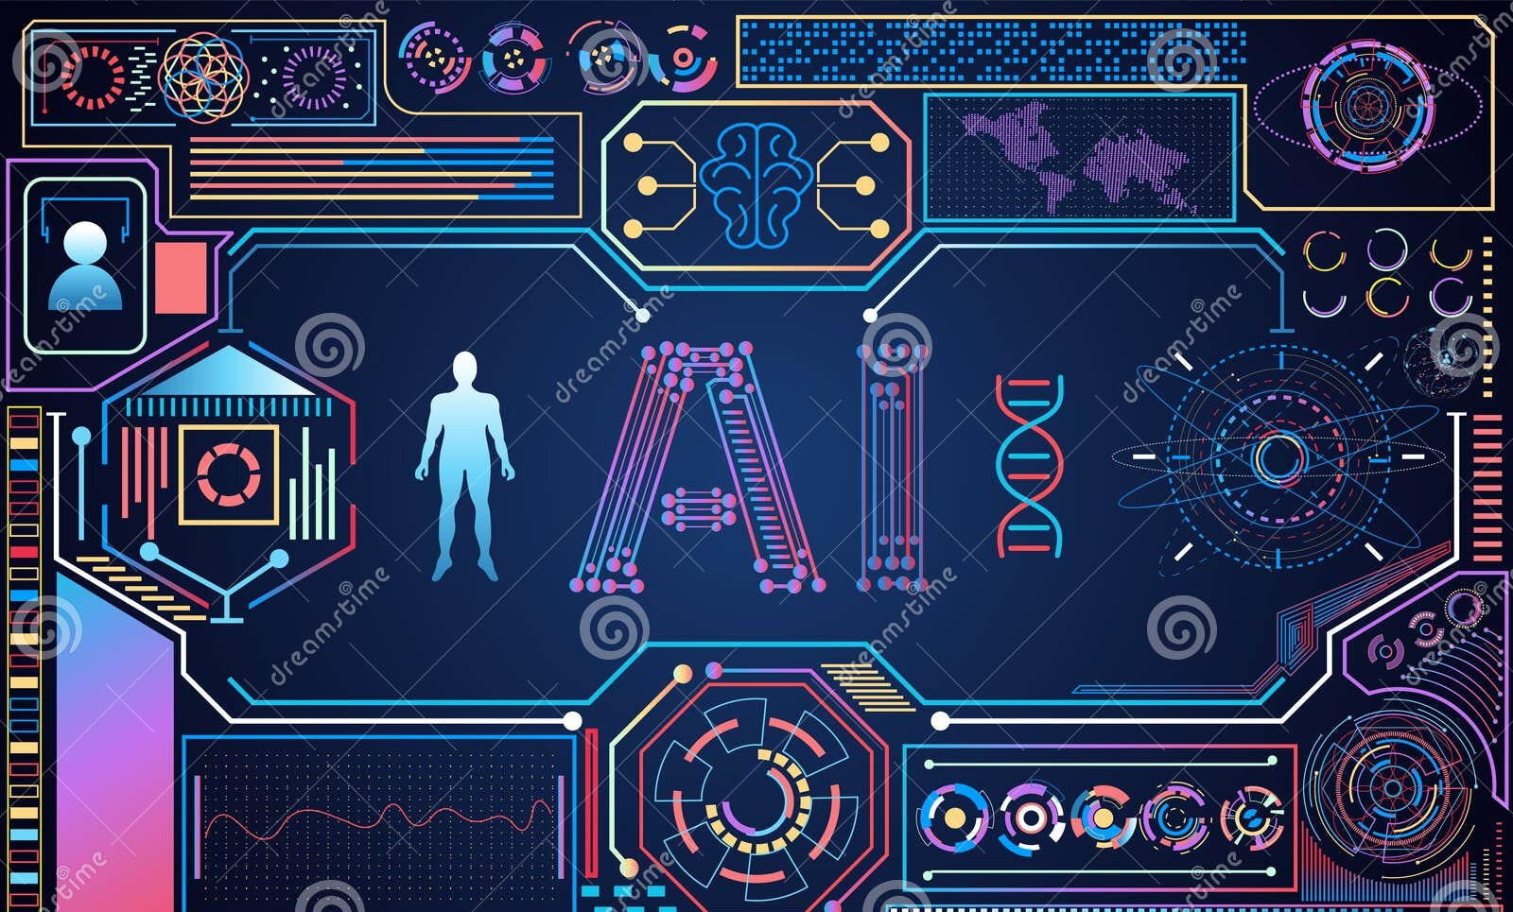
ABSTRACT
Nova AI is an intelligent conversational system
Designed to understand user queries and respond accurately
Built using structured SDLC methodology
Focuses on scalability, reliability, and modular design

Slide 3

INTRODUCTION
Artificial Intelligence enables human-like communication
Chatbots are widely used in support, education, and automation
Nova AI is a backend-driven AI assistant
SDLC ensures systematic and error-free development

Slide 4
WHY SDLC?
Provides a structured development approach
Reduces errors and rework
Improves software quality
Makes future maintenance easier

Slide 5
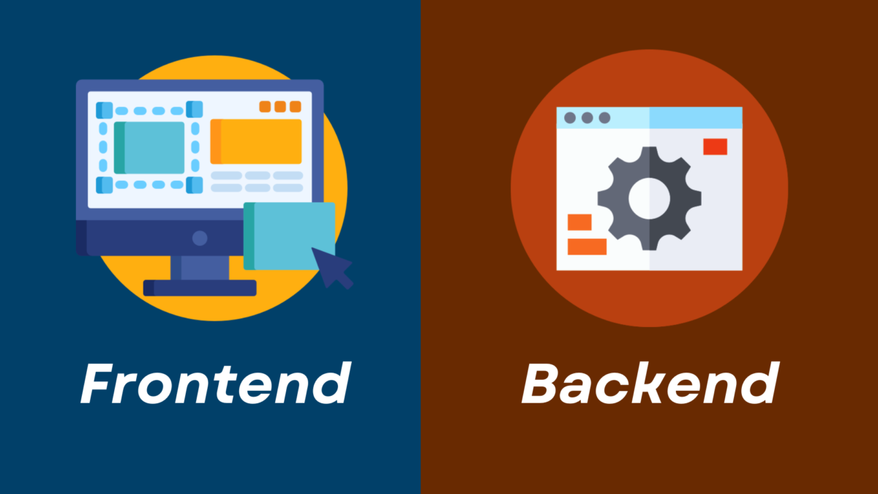
PROBLEM STATEMENT
Traditional chatbots are rule-based
Limited understanding of natural language
Cannot scale efficiently
Need for an AI-powered conversational agent

Slide 6
PHASE 1: REQUIREMENT ANALYSIS
Functional Requirements:
Accept user text input
Generate AI-based responses
Handle API requests securely
Non-Functional Requirements:
Fast response time
Secure API usage
Easy user interaction

Slide 7
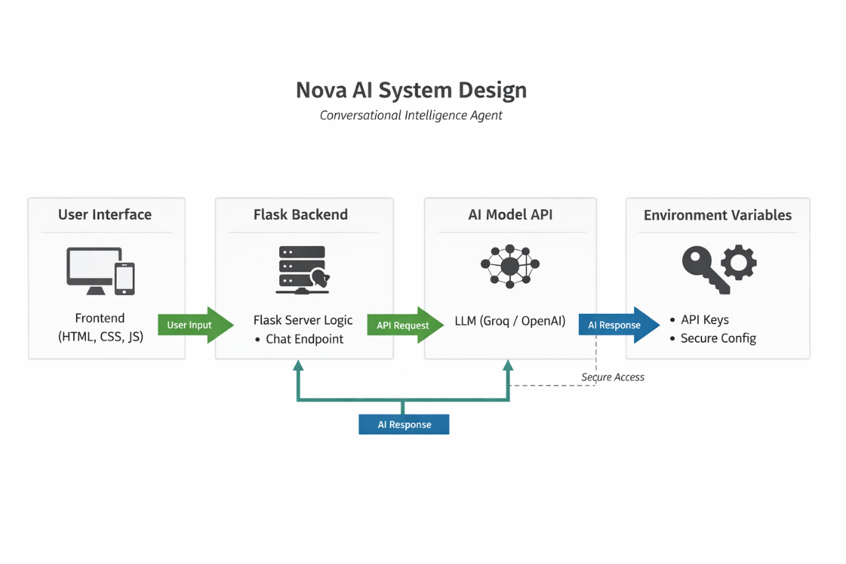
PHASE 2: SYSTEM DESIGN
Client–Server architecture
Modular design approach
Separate frontend and backend
AI logic handled independently

Slide 8
SYSTEM ARCHITECTURE
Components:
User Interface (Frontend)
Flask Backend Server
AI Model API
Environment Variables

Slide 9
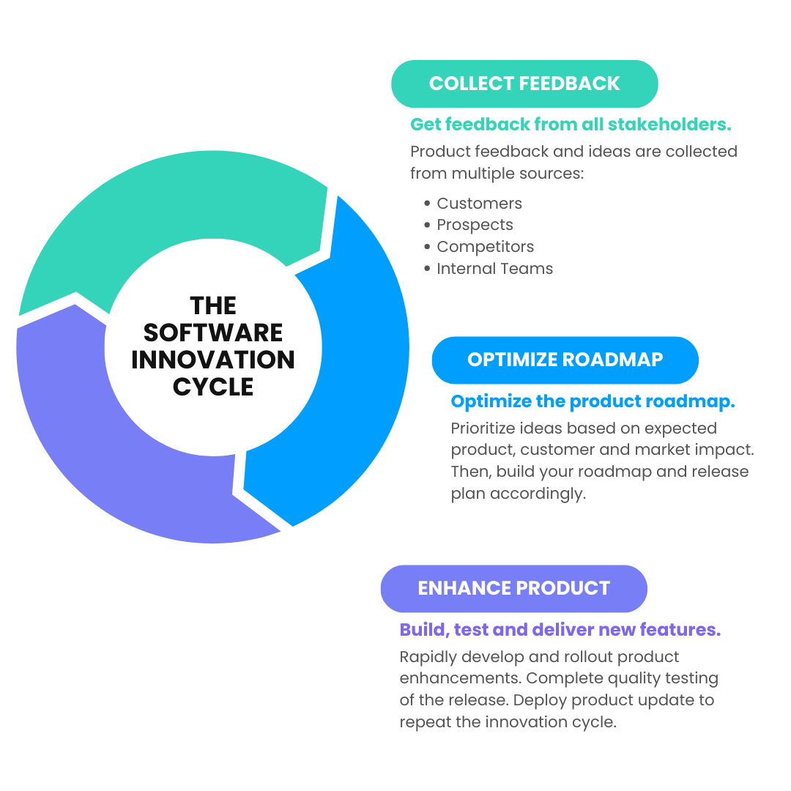
SYSTEM FLOW
User enters message
Frontend sends request
Backend processes request
AI model generates response
Output displayed to user

Slide 10
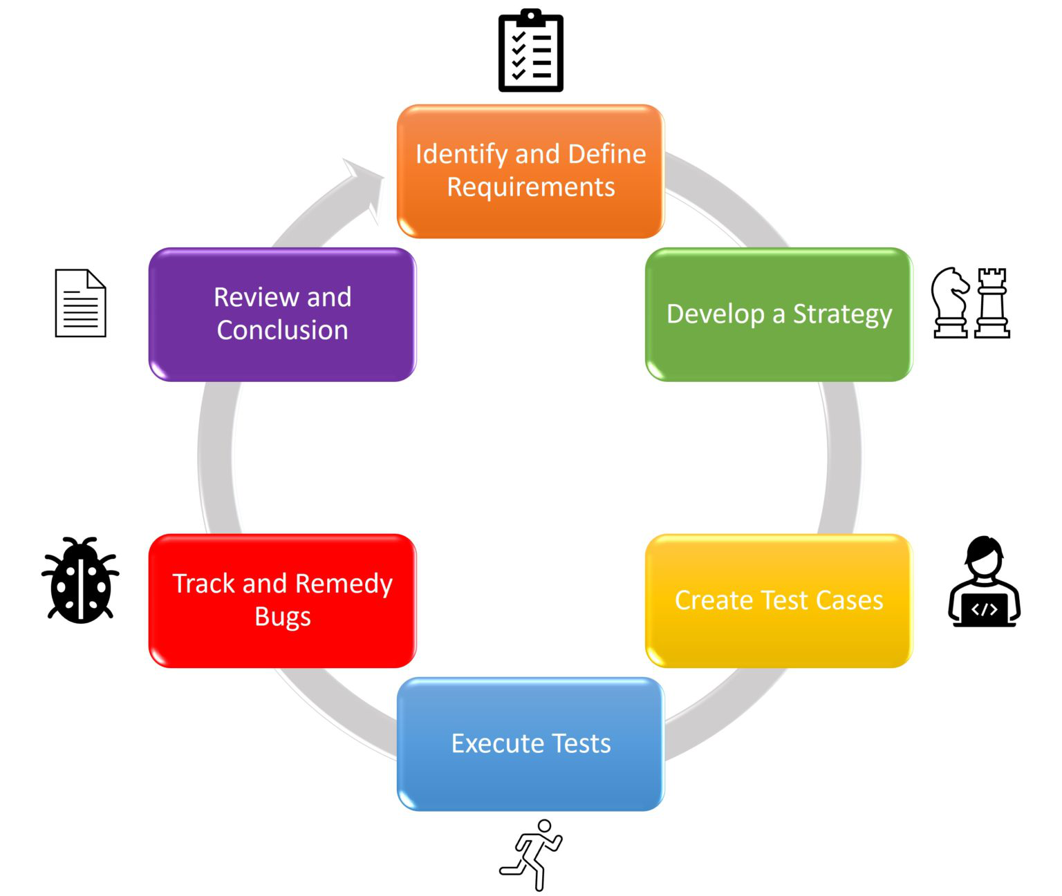
PHASE 3: IMPLEMENTATION
Technologies Used:
Python – Core programming
Flask – Backend framework
REST API – Communication
AI Models – Response generation

Slide 11
PROJECT STRUCTURE
Nova-AI/
├── backend/
│ ├── app.py
│ ├── ai_client.py
│ ├── test_groq.py
│ └── .env
├── frontend/
│ ├── index.html
│ ├── style.css
│ └── script.js

Slide 12
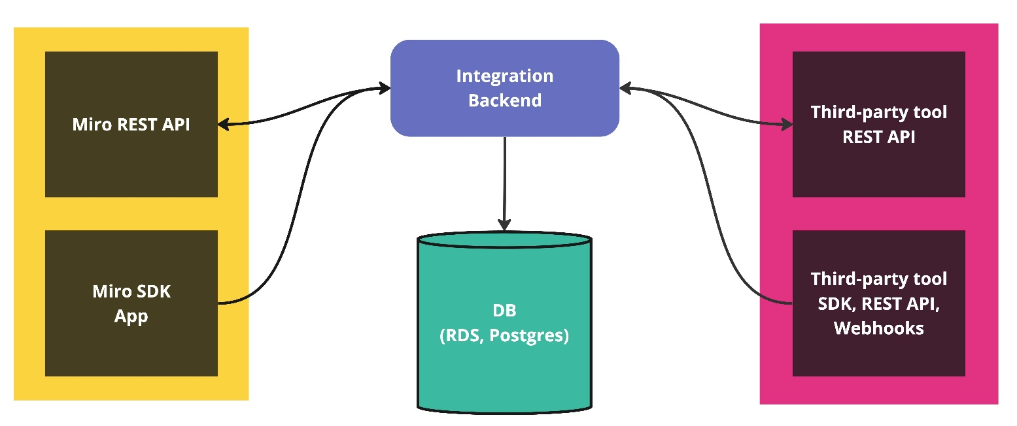
BACKEND WORKING
Flask server listens to requests
/chat API endpoint created
Input sent to AI model
Response returned to frontend

Slide 13
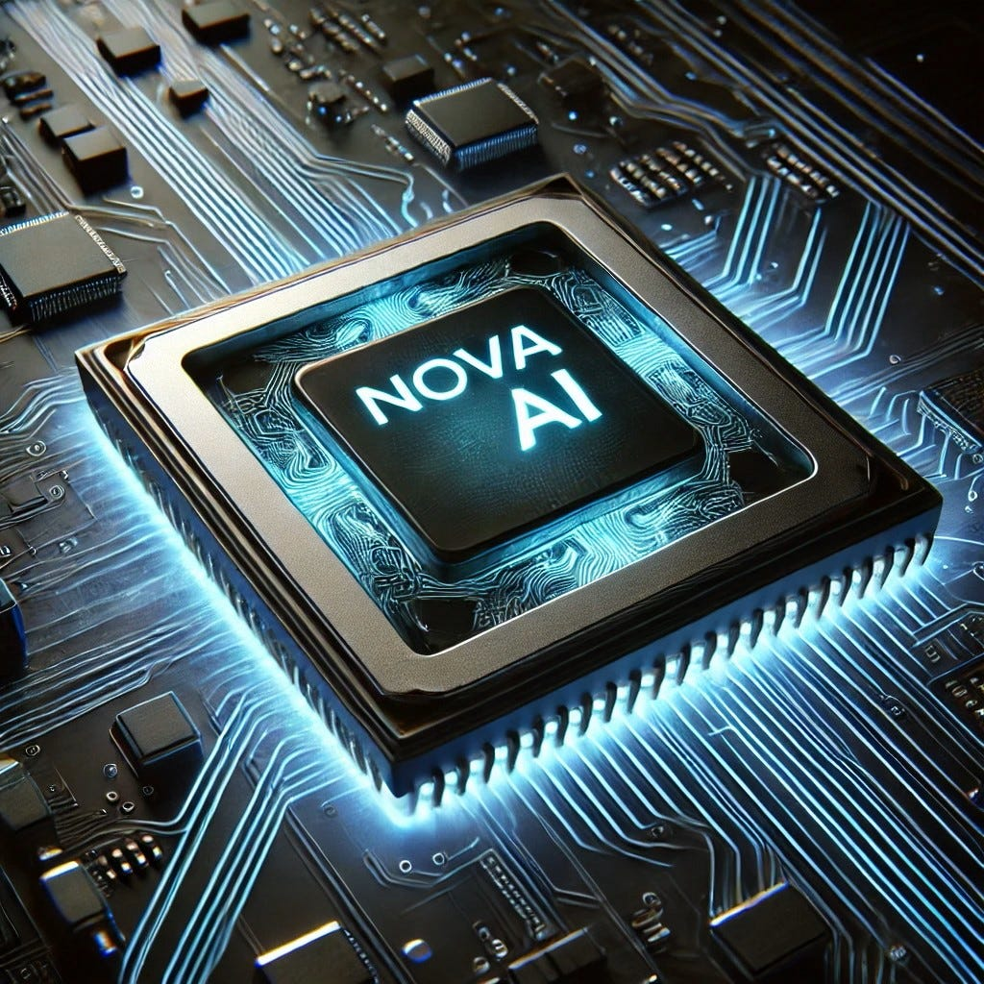
AI MODEL INTEGRATION
AI client handles API communication
API keys stored securely
Model generates intelligent replies
Response formatted and returned

Slide 14

PHASE 4: TESTING
Testing Methods:
Unit Testing
API Testing
Integration Testing

Slide 15
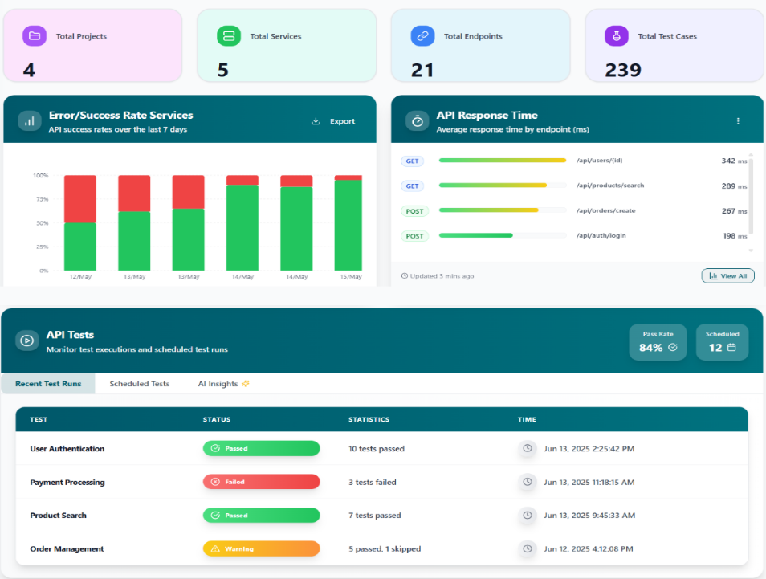
TEST RESULTS
Valid inputs give correct responses
Errors handled properly
API failures managed graceful

Slide 16

PHASE 5: DEPLOYMENT
Local deployment using Flask
Environment variables configured
Ready for cloud deployment

Slide 17
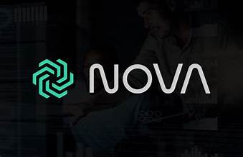
PHASE 6: MAINTENANCE
Easy bug fixing
Model replacement possible
Feature upgrades supported

Slide 18
FEATURES
Real-time AI responses
Modular SDLC-based design
Secure API handling
Scalable architecture

Slide 19
LIMITATIONS
Requires internet connection
API rate limits
No long-term memory
Single-user focus

